Slide 1
SWIGGY

Slide 2
INTRODUCTION
Swiggy is one of India’s leading food delivery platforms, founded in 2014.
Mission:
To bring the best food to the customers' doorstep with a seamless and quick delivery experience.
Growth:
Rapidly expanded to cover numerous cities across India, partnering with thousands of restaurants.
Services:
Besides food delivery, Swiggy has diversified into groceries and other on-demand services.

Slide 3
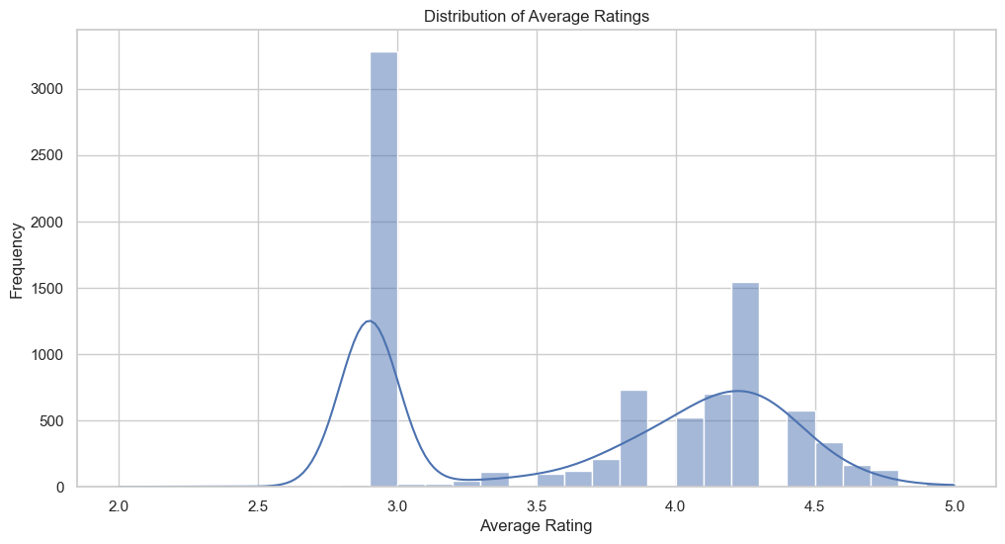
Average Rating
Reflects customer satisfaction.
Influences restaurant reputation and customer
choice.
Most restaurants have average ratings
between 3.0 and 4.5

Slide 4
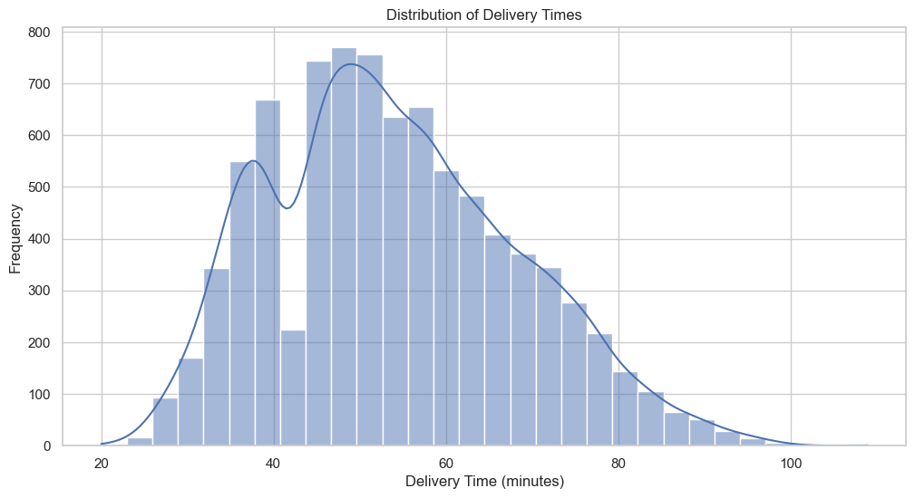
Delivery Times
Most deliveries take between 50
and 60 minutes
Longer deliver times include traffic
and high pay demands
Optimizing delivery routes and
preparation times

Slide 5
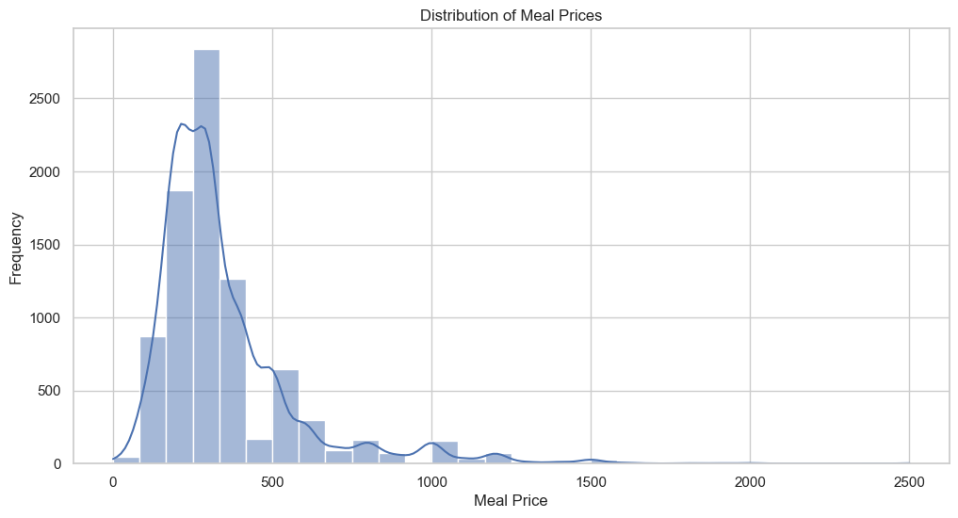
Meal Prices
The majority of meals are affordably priced,
catering to a broad customer base
The presence of higher-priced meals indicates
a variety of premium options

Slide 6
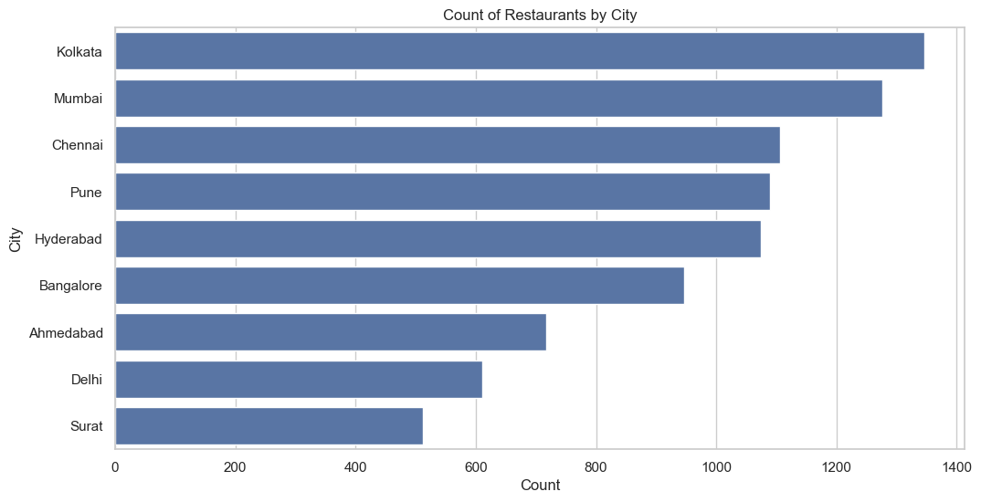
Restaurant by City
Bangalore is a major hub for Swiggy
Focus on expanding restaurant partnerships in
other cities could enhance market presence and
service availability.

Slide 7
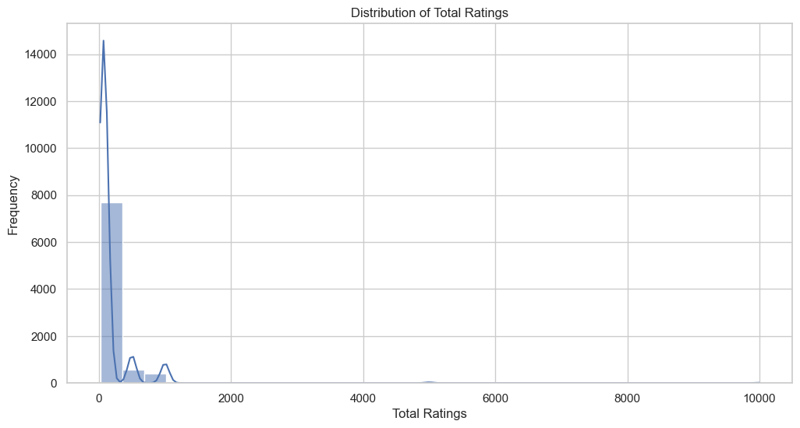
Total Ratings
A small number of restaurants dominate in terms of total
ratings, indicating their popularity.
Strategies to increase visibility and customer engagement
for restaurants with lower ratings could involve targeted
marketing and promotional activities.

Slide 8
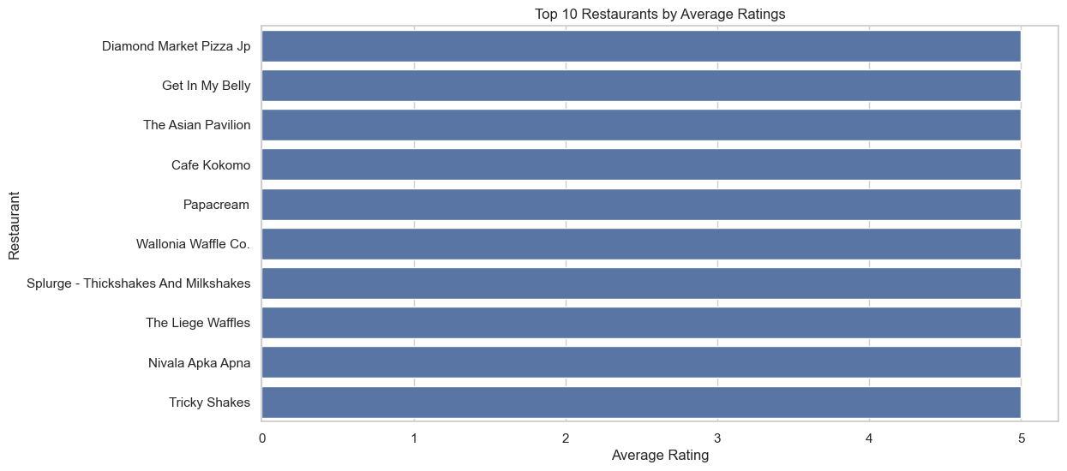
Top 10 Average Ratings
These top-rated restaurants consistently deliver
high-quality food and excellent customer service.
Restaurants with high ratings often have a strong
reputation and a loyal customer base.

Slide 9
Conclusion
Ratings: Most restaurants have good average ratings, typically between 3.0 and 4.5.
Delivery Times: Delivery times are generally reasonable, with most deliveries taking between 50
and 60 minutes.
Meal Prices: Meal prices vary widely, with a significant number of meals priced between 200-400.
Restaurant Distribution: The majority of restaurants are concentrated in specific areas and cities, with Bangalore having the most listings.
Top Restaurants: Identified the top 10 restaurants based on average ratings.
Food Variety: A wide variety of food types are offered, catering to diverse customer preferences.
future business strategies.

